Slide 1
Predicting Heart Disease Risk with Machine Learning
Larry Vue – DS 785 Capstone
Business Problem:
  Detect heart disease in patients earlier
Project Objective:
  Build and evaluate a risk model
Today’s Focus:
  Share Results, Key insights, and recommendations
Notes:
“Hi, I’m Larry Vue, and this is my DS 785 capstone project on predicting heart disease risk with machine learning.
Heart disease is still a leading cause of illness, death, and healthcare spending. In routine care, clinicians already capture information such as age, blood pressure, cholesterol, and exercise test results, but it’s hard to combine these into a consistent, usable risk signal at the point of care.
In this project, I built and evaluated a model that uses those routine variables to estimate a patient’s risk of heart disease. In this final presentation, I’ll briefly recap the data and methods, then focus on the model’s results, what the risk scores mean for clinicians and care managers, and how a health organization could deploy and maintain a tool like this.”

Slide 2
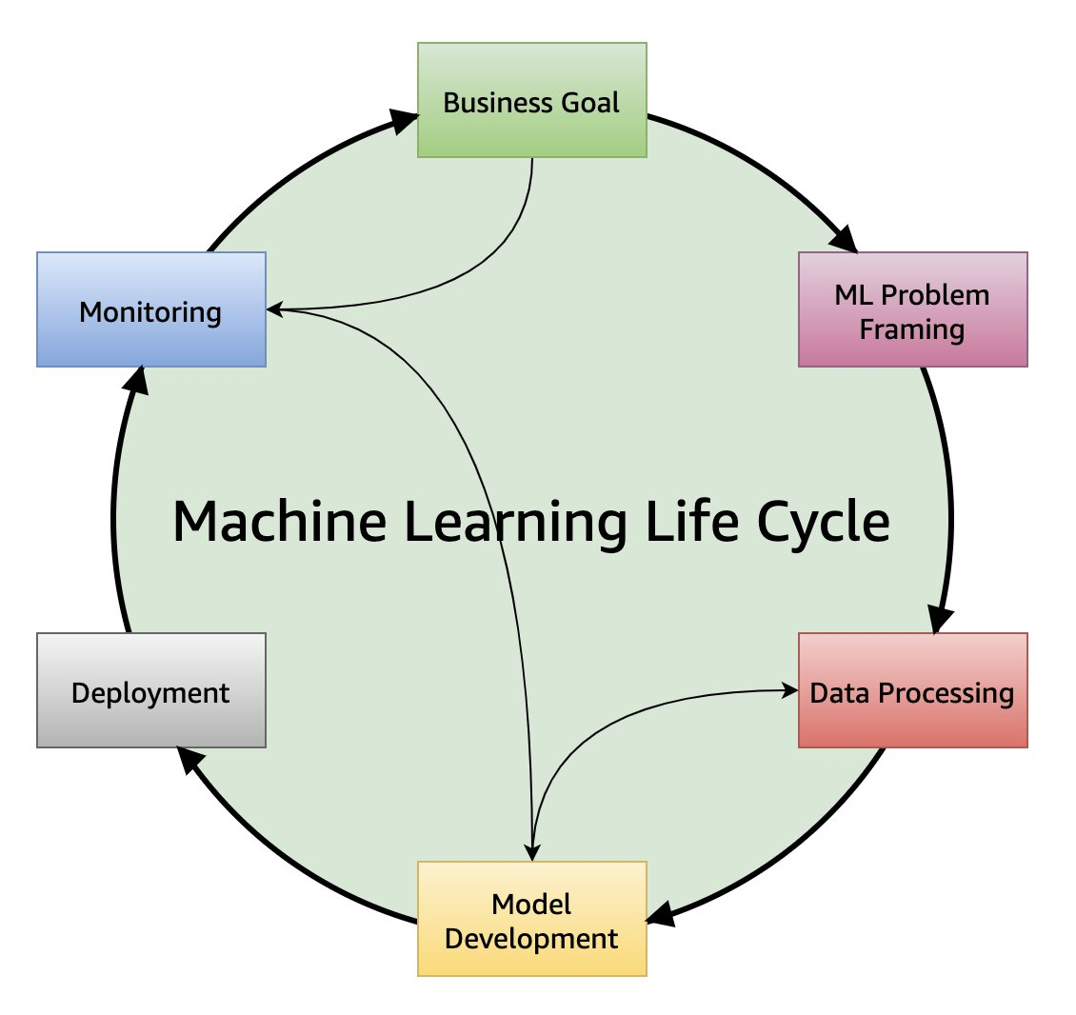
Data & Methods Recap
Data Sources:
  Cleveland Clinic Heart Disease Dataset
  Cardiovascular dataset (Kaggle)
  Target: binary heart disease present vs absent
Methods:
  Cleaned and aligned shared variables across both datasets
  Split data into train/test sets with cross-validation
  Compared baseline, logistic regression, & tree models
  Evaluated ROC-AUC, recall, precision, and calibration
Notes:
“Before I show results, here’s a quick recap of the data and methods.
I used two primary sources: the Cleveland Clinic heart disease dataset, which is smaller but clinically detailed, and a much larger cardiovascular dataset from Kaggle for validation. In both, the goal was to predict a simple binary outcome: whether heart disease is present or absent.
I cleaned and aligned overlapping variables like age, blood pressure, cholesterol, and exercise-related measures, then split the data into training and test sets using cross-validation to tune the models. I compared a baseline approach, logistic regression, and tree-based models, and ultimately selected a calibrated logistic regression as the final model because it offered strong performance and clear interpretability. Performance was evaluated using ROC-AUC for ranking quality. Recall and precision were to understand errors, and calibration to see whether predicted risks match observed rates.”
“With that foundation, let’s look at internal performance and how I chose the operating threshold.”

Slide 3
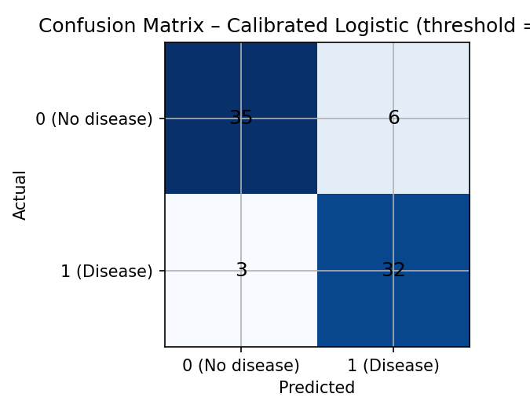
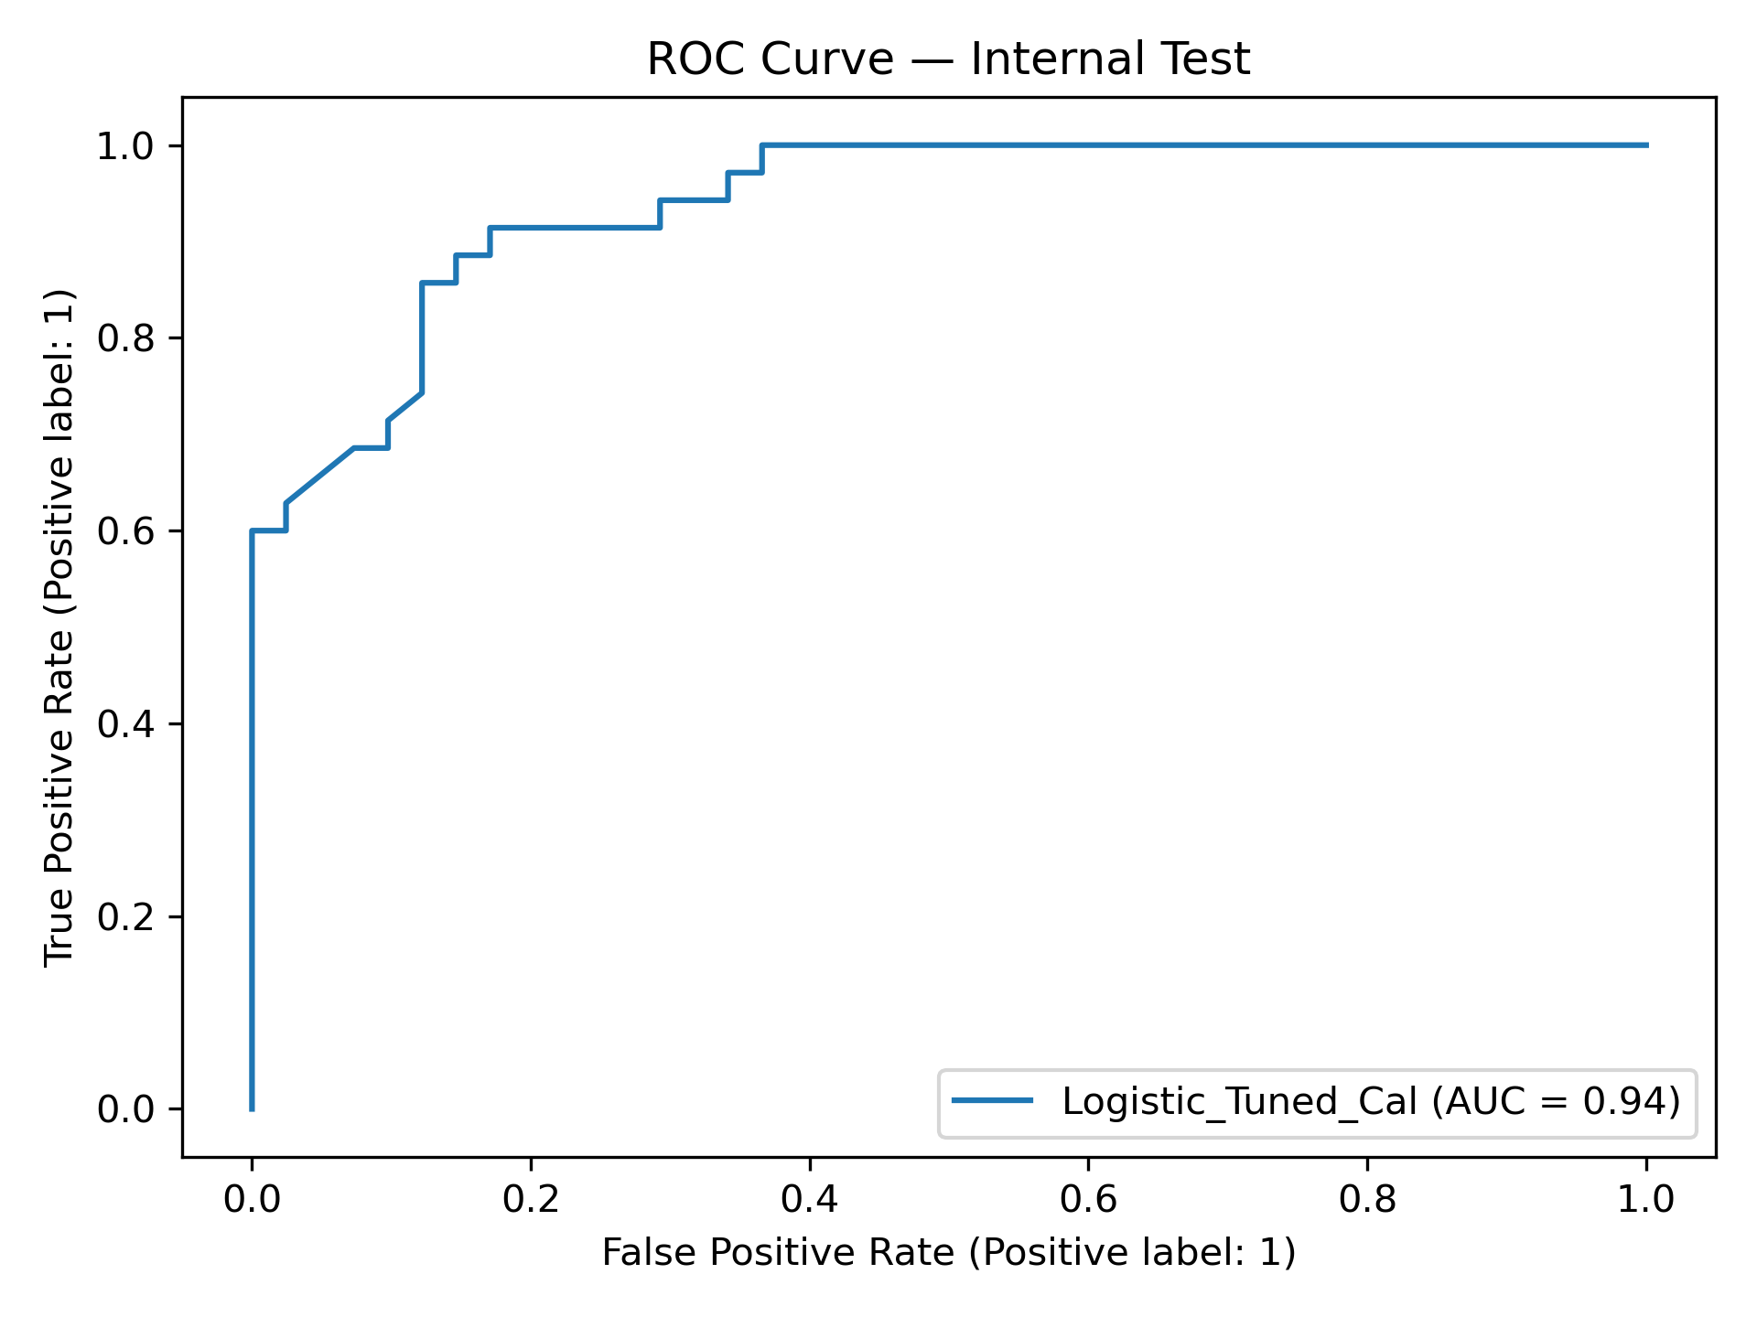
Final Model (Full Features) — Internal Results
Dataset internal - cutoff | ROC-AUC | Recall | Precision | F1
0.50 | 0.939 | 0.89 | 0.83 | 0.85
0.45 | 0.939 | 0.91 | 0.84 | 0.86
0.40 | 0.939 | 0.91 | 0.84 | 0.86
ROC-AUC ≈ 0.94 at all three cutoffs, so the model consistently ranks risk well
At cutoff 0.45, recall increases to 0.91 while precision stays around 0.84
Confusion matrix at 0.45 shows 3 missed cases (false negatives) and 6 false alarms (false positives)
Notes:
“Here are the internal test results for the calibrated logistic model.
The table on the left shows that ROC-AUC is about 0.94 across all cutoffs, which shows the model consistently separates patients with and without heart disease. When I move the cutoff from 0.50 down to 0.45, recall increases from 0.89 to 0.91, while precision stays roughly stable around 0.84.
The confusion matrix on the right is at the 0.45 cutoff. We see 3 missed cases, or false negatives, and 6 false alarms, or false positives. For an early screening use case, that trade-off is acceptable, so I use 0.45 as the operating point for the rest of the analysis.”
Now that we’ve seen how the model performs internally, the next step is to see how well this signal carries over to an external cardiovascular dataset.”

Slide 4
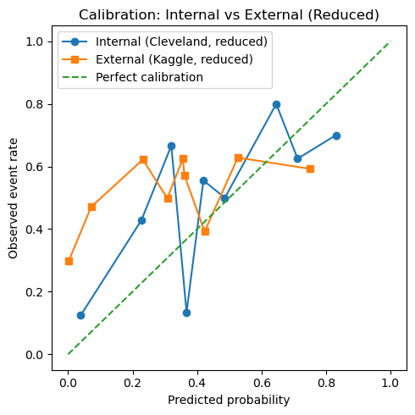
External Validation & Reduced Features
Dataset | ROC-AUC | Recall | Precision | F1
Internal | 0.683 | 0.57 | 0.65 | 0.61
External | 0.593 | 0.26 | 0.61 | 0.36
Reduced Model: age, sex, systolic BP ( match Kaggle fields)
Results 0.45: Internal vs external; expected AUC/recall drop, but ranking signal holds
Proper external validation needs Cleveland variables (cp, thal, oldpeck, ect.)
Notes:
“To get a fair external check, I focused on the variables that exist in both datasets. The Kaggle cardiovascular data does not include some of Cleveland’s key clinical features, so I trained a reduced model on Cleveland using only age, sex, and systolic blood pressure.
The table compares performance at the same recall cutoff of 0.45. As expected, both AUC and recall are lower on the external data because we’re using only three predictors. Precision, however, is similar, and the calibration curves show that the model still carries a usable ranking signal, even if it is noisier.
I treat this as a compatibility check rather than a full external validation. A proper validation step would use a clinical dataset with variables similar to Cleveland, but this shows how the model might behave when moved to a broader population.”
“Now I’ll translate model performance into expected review workload and cost at the chosen threshold.”

Slide 5
Business Impact & Workload Analysis
Threshold | Recall | Precision | Flagged % | Flagged / 1000 | Est. Cost / 1000*
0.50 | 0.50 | 0.60 | 38.5% | 385 | $77k
0.45 | 0.57 | 0.59 | 45.1% | 451 | $90k
0.40 | 0.62 | 0.58 | 49.5% | 495 | $99k
Operating Point: Recall-first threshold ≈ 0.45 (minimize missed cases)
Workload at 0.45: ~45% flagged (≈ 450/1000 patients)
  Follow-up costs 450 x $200 ≈ $90k/1000 (placeholder)
Start at 0.45, monitor precision and adjust ±0.05 to match clinic capacity as a needed bases
Notes:
“This slide shows what our threshold choice means operationally. The table summarizes recall, precision, and the number of patients flagged at each cutoff. At a threshold of 0.45, about 45 percent of patients are flagged, which is roughly 450 out of every 1,000 screened, who would get some kind of follow-up for heart disease risk.
To size the cost, I use a simple ‘what-if’ example: if each follow-up visit or test costs around $200, that works out to about $90,000 per 1,000 patients. Clinics can plug in their own unit cost and see the number scale directly.
As we see on the table, lowering the threshold further would reduce missed cases but increase flagged volume and costs; raising it would do the opposite. So 0.45 is a reasonable starting point, with the option to adjust the cutoff slightly up or down based on staffing and budget.”
Before we interpret features, let’s confirm the probabilities are trustworthy—here’s the calibration check.”

Slide 6
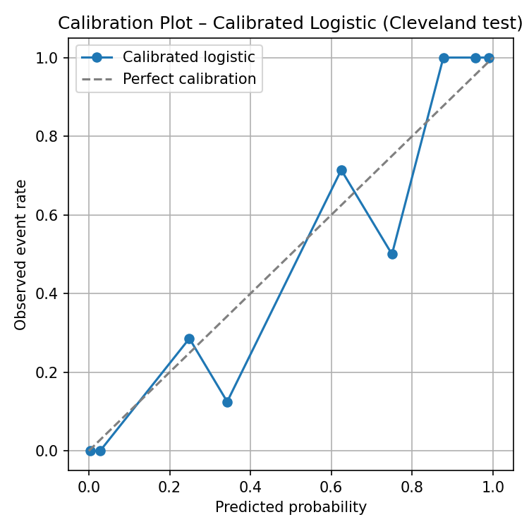
Calibration (Probabilities Trustworthy?)
Calibrated logistic: predicted risk ≈ observed event rate
Most reliable in mid-risk range; some wobble at the edges is expected with small data
Supports using scores as screening risk bands and makes cutoffs easier to explain
Notes:
“This slide checks whether the model’s probabilities are trustworthy. On the x-axis we have the predicted risk from the calibrated logistic model, and on the y-axis we have the actual event rate in the Cleveland test set. The dashed line is perfect calibration — where predicted and observed risk would match exactly.
The blue points stay fairly close to that line, especially in the mid-range of probabilities, which tells us the calibrated model’s risk scores are reasonably well aligned with reality. For example, when the model predicts around a 60 percent risk, roughly six out of ten similar patients actually have heart disease. That makes a cutoff like 0.45 easier to explain to clinicians, because it corresponds to a concrete expected yield.
“Now that the probabilities align with observed rates, let’s see what actually drives the score, by the top features and their directions.”

Slide 7
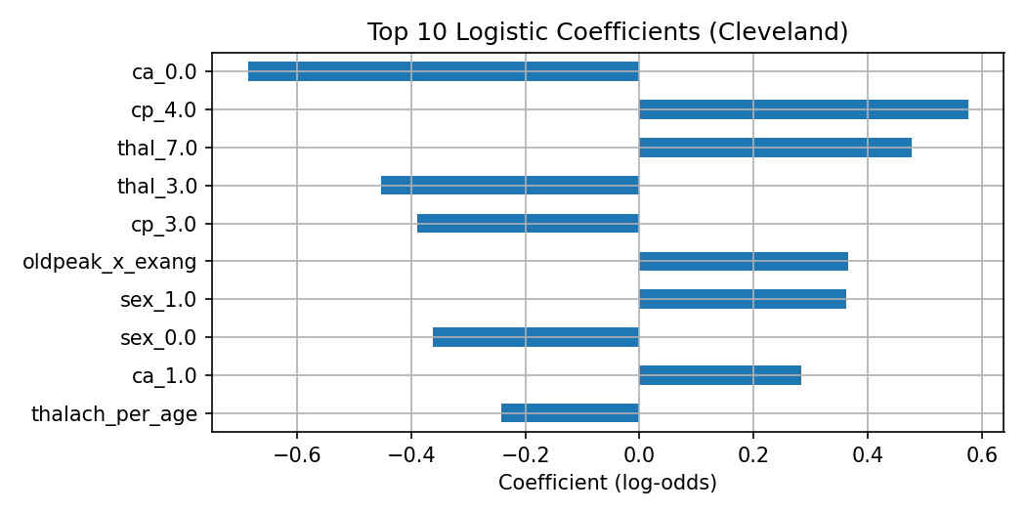
Interpretability
Higher risk pattern: angina-type or asymptomatic chest pain, abnormal thallium scan, exercise-induced chest pain, narrowed vessels, lower max heart rate, male
Lower risk pattern: normal thallium scan, no narrowed vessels, non-anginal chest pain, higher max heart rate, female
Directions match EDA and basic cardiology, which supports using the model as a recall-first screening tool
Notes:
“This slide shows which factors drive the logistic model. Bars to the right increase the predicted risk of heart disease, bars to the left decrease it.
Higher risk patterns include angina-type or asymptomatic chest pain, abnormal thallium imaging, exercise-induced chest pain, narrowed coronary vessels, a lower maximum heart rate for age, and male sex.
Lower-risk patterns are the opposite: a normal thallium scan, no narrowed vessels, non-anginal chest pain, a higher max heart rate, and female sex.
These directions line up with both our exploratory analysis and standard cardiology research, which makes the model easier to explain and supports using it as a recall-first screening tool.”
“Now that we know what’s driving risk, let’s look at how the model behaves on errors and workloads.”

Slide 8
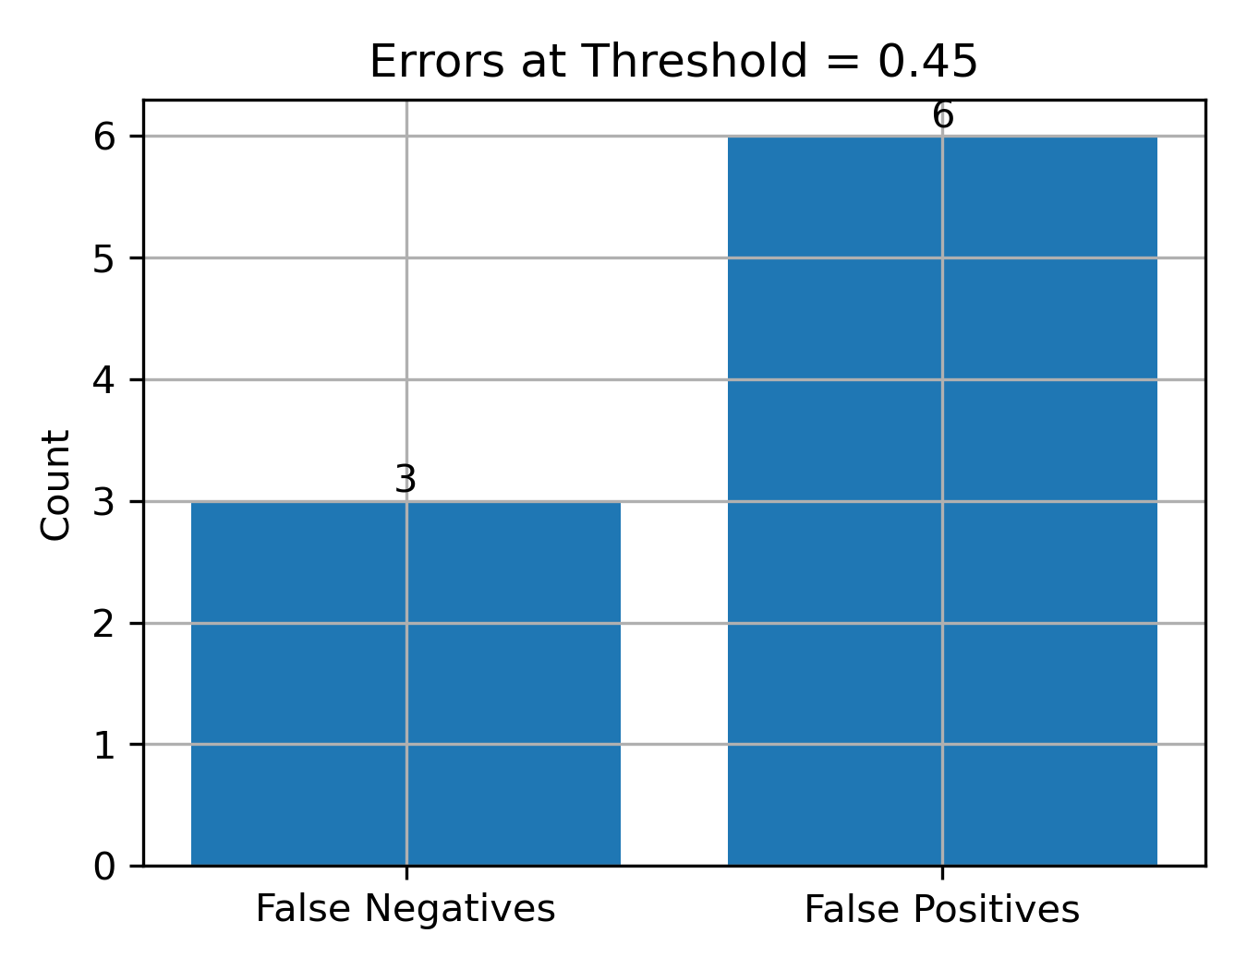
Error Analysis (Cutoff = 0.45)
Error mix at 0.45: 3 false negatives and 6 false positives
False negatives: “quiet” cases – somewhat younger, non-anginal symptoms, no exercise-induced chest pain, but higher ST-depression
False positives: older patients with lower max heart rate; model will flag still
Mitigation: recall-first threshold calibration, and simple interactions (age × max heart rate, ST-depression × slope)
Notes:
“At our operating cutoff of 0.45, the model makes three false negatives and six false positives on the Cleveland test set.
The false negatives tend to be ‘quiet’ cases: patients who are somewhat younger, report non-anginal chest pain, and have no exercise-induced chest pain, but do show higher ST-segment depression. They don’t look obvious, so they’re hard for both clinicians and the model to catch.
The false positives are mostly older patients with a lower maximum heart rate and modest ST-changes. In a screening context, the model is intentionally conservative and flags them, which is acceptable as long as the follow-up is relatively low cost.
To reduce misses, I use a recall-first threshold and include a couple of simple interactions, such as age with max heart rate, and ST-depression with slope. This helps with separating these borderline cases.
“With that error picture in mind, let’s look at a simple deployment and governance plan.”

Slide 9

Deployment Plan and Monitoring
Model: Calibrated logistic, cutoff ≈ 0.45; flagged patients get BP recheck, chart review, then nurse outreach if needed
Guardrails: ≤ 45% flagged; Precision ≥ 0.80; FN audit
Governance: Monitor AUC, recall, precision, and calibration by sex/age; adjust threshold if workload or precision drifts; recalibrate or retrain if AUC drops
Notes:
“For deployment, I assume a calibrated logistic model with a recall-first cutoff around 0.45, so fewer true heart-disease cases are missed. When the model flags a patient, the demo workflow is simple: recheck blood pressure, do a quick chart review, and if risk still looks high, then a nurse outreach or follow-up visit may be needed.
To keep the workload realistic, about 45 percent of patients were flagged, and a target precision of at least 0.80 was set, along with periodic review of any missed cases.
On the monitoring side, I would track AUC, recall, precision, and calibration over time, broken out by sex and age. If precision or flagged volume drifts, the threshold may need to be adjusted. That would trigger recalibration or retraining with more recent data.”
With that process in place, I’ll close with the key takeaways and next steps.”

Slide 10

Key Takeaways & Future Steps
Decision: Deploy Logistic_Tuned , cutoff ≈ 0.45 (recall-first)
Internal performance: AUC ≈0.94, Recall ≈0.89, Precision ≈0.84
Business Impact: Fewer misses; threshold tunes follow-up volume
Limitations: Small Cleveland sample, reduced-feature external test, snapshot data
Next/Future: Batch-scoring demo + calibration; full external validation
Notes:
“To wrap up, I’m selecting a calibrated logistic model with a recall-first cutoff around 0.45 because it misses fewer true heart-disease cases. On the Cleveland test set, it performs well, with an AUC of around 0.94, a recall of 0.89, and a precision of 0.84. The threshold gives us a basis for tuning follow-up volume and cost.
This work is still limited by a relatively small Cleveland sample, a reduced-feature external check, and snapshot clinical variables. So the scores should be treated as decision support, not as a final diagnosis.
Next, is to study this in a clinic setting and monitor flagged volume and accuracy over time. Longer term, a full external validation with a richer clinical dataset for a more realistic overview.
Thanks for listening.

